Slide 1
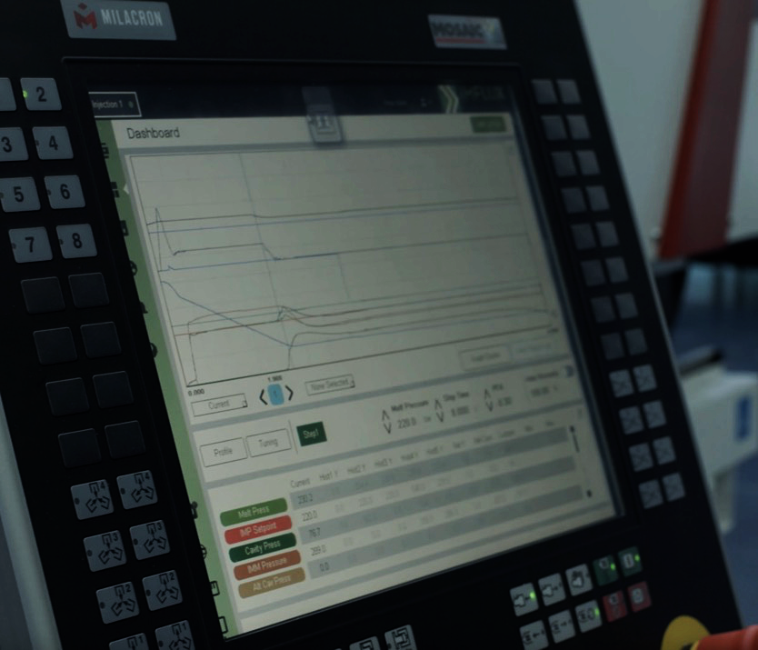

Slide 2


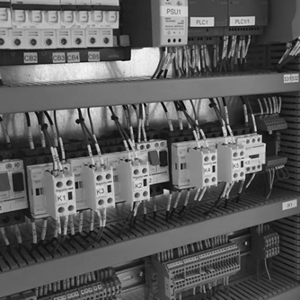
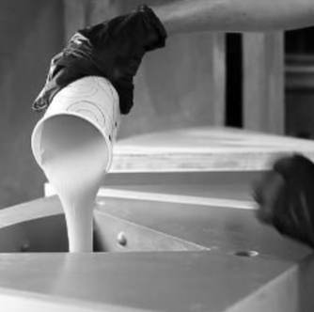
Software
Develop
Software
Integrate to
an Injection
Molding Machine
Changes
How Plastic
is Formed

Slide 3

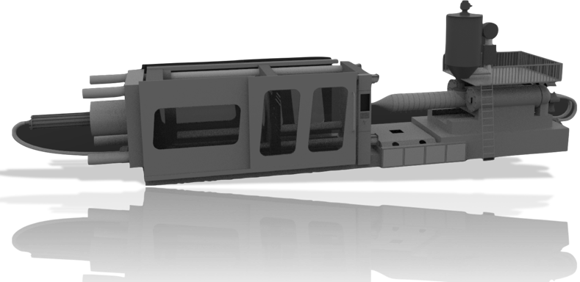

THE iMFLUX SYSTEM
LOW CONSTANT PRESSURE MOLDING PLATFORM
PRESSURE
SENSOR
USER
INTERFACE
SOFTWARE

Slide 4
Advantage
IMPROVES
OEE
ENABLES MATERIAL FLEXIBILITY
IMPROVES QUALITY
REDUCES PRESSURE & TONNAGE
ALLOWS FOR LIGHT WEIGHTING
SUSTAINABILITY ADVANTAGES
σ
!
6

Slide 5
CONVENTIONAL MOLDING PROCESS
High Pressure
High Shear
PLASTIC PRESSURE
Static Process
FILL
PACK/HOLD
COOL
TIME

Slide 6
The “GREEN CURVE”
More Efficient
MUCH
LOWER
PRESSURE
Better Quality
Reduce Cost
PLASTIC PRESSURE
Lower Capital
FASTER
CYCLETIME
Less Wear
TIME

Slide 7
The “GREEN CURVE”
SLOWER FILL RATE
Packs-as-it-Fills
PLASTIC PRESSURE
No Flow Hesitation
~ 95% Full
~ 95% Full
TIME

Slide 8
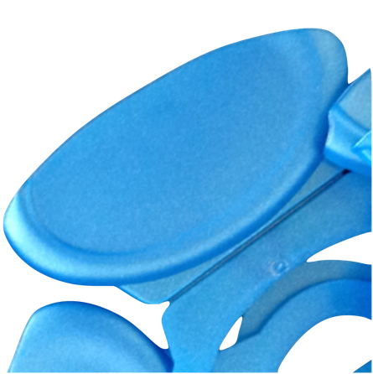
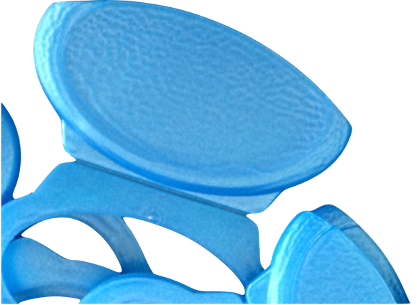
Packs-as-it-Fills
Faster Cycle
CONVENTIONAL
iMFLUX
Less Sink
Better Surface Finish
Lighter Parts

Slide 9
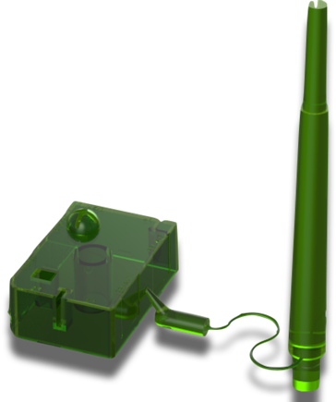
No Hesitation
”Perfect” Laminar Flow
Design Possibilities
Thinner Parts
Smaller Cold Runners

Slide 10
The “GREEN CURVE”
Dynamic Process Adapts In Realtime
✓
Increased Viscosity
Run highly variable materials, well beyond what is practical with traditional molding
Decreased Viscosity
ADAPTS
REALTIME
PLASTIC PRESSURE
CONSISTENT
FILL TIME
TIME

Slide 11

iMFLUX – Adapts In Realtime
Similar to adaptive driving features, iMFLUX recognizes changing conditions and adapts in realtime

Slide 12
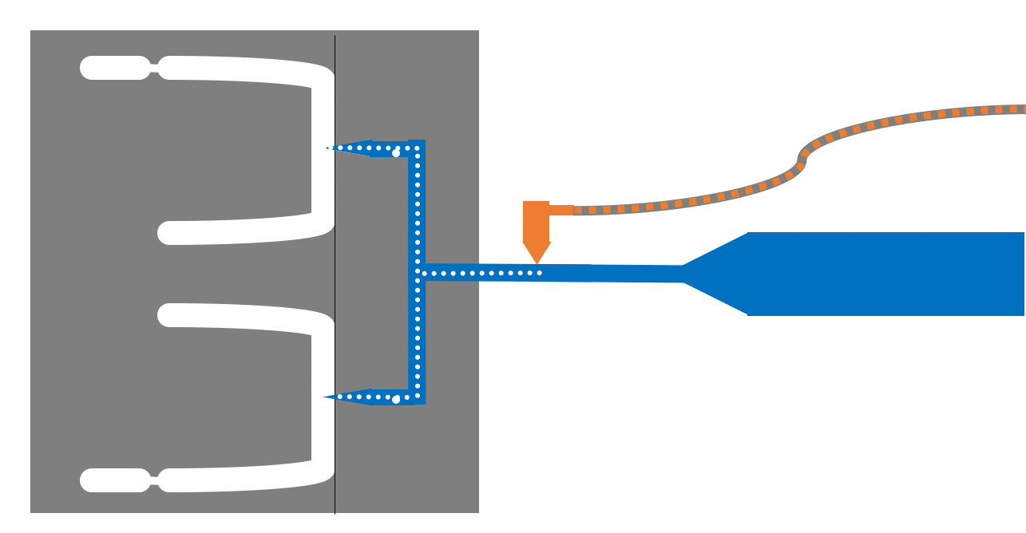
iMFLUX – Control Platform
Adapts In Realtime
High Resistance
Increased Resistance
Initial Resistance
Realtime Flow Front Position
Realtime Cavity Pressure
No Sensors Required in the Mold
Screw Velocity Varies To Maintain Constant Pressure

Slide 13
A GREENER PROCESS

Slide 14
Sustainability Benefits
1
2
3
SUSTAINABLE ALTERNATIVES
LOWER ENERGY WEAR & WASTE
LIGHTER
PARTS

Slide 15
1
Recycled Plastic
Heat & Shear Sensitive Materials
Composite Materials
SUSTAINABLE ALTERNATIVES

Slide 16
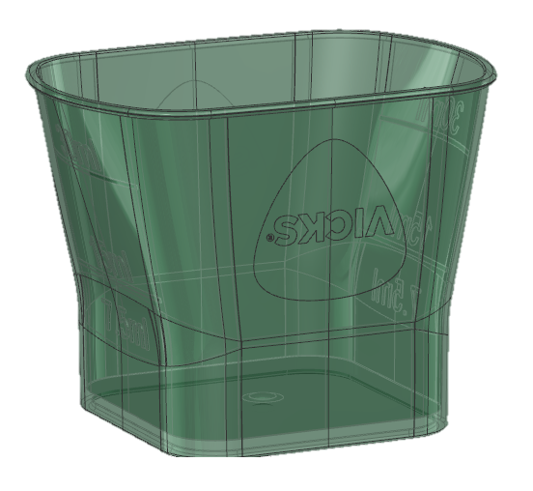
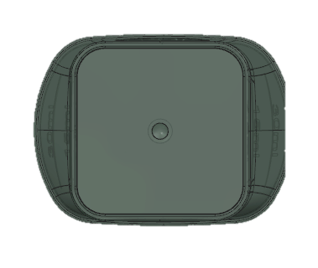
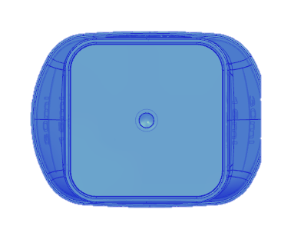
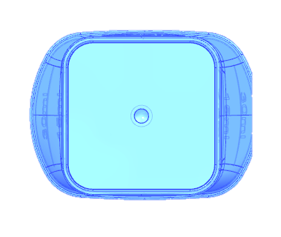
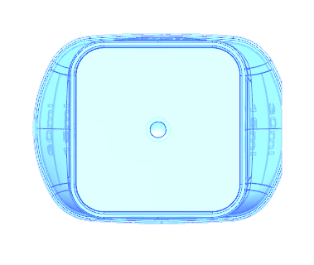
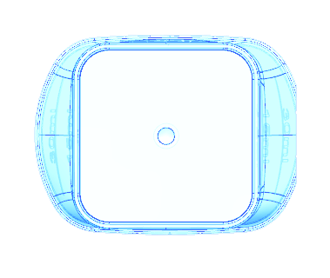
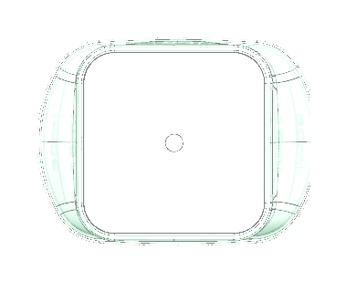
Auto Viscosity AdjustTM
Run highly variable materials,
particularly post consumer recycled materials
6 MFI
55 MFI
Adapts Automatically
CONSISTENT PART WEIGHT • CONSISTENT PART QUALITY

Slide 17
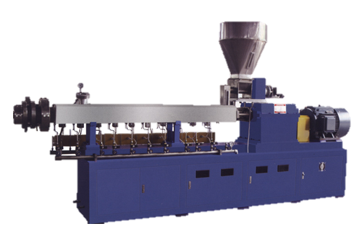
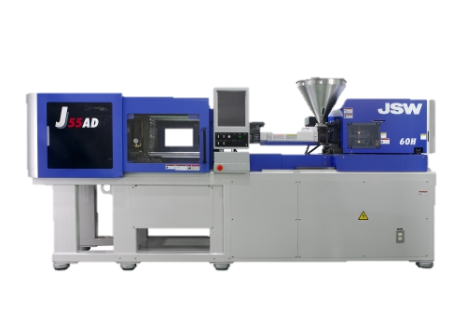
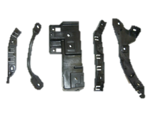
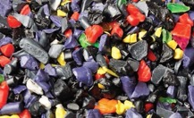
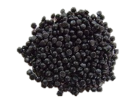
TRADITIONAL RECYCLING PROCESS
Re-pelletize to achieve material consistency
1
2
3
4
5
Raw Recycle | Extruder | Pellets | Injection Mold | Parts

Slide 18
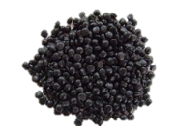
TRADITIONAL RECYCLING PROCESS
Re-pelletize to achieve material consistency
1
2
3
4
5
HARD TO DO
Raw Recycle | Extruder | Pellets | Injection Mold | Parts

Slide 19

TRADITIONAL RECYCLING PROCESS
Re-pelletize to achieve material consistency
✘
✘
1
2
3
4
5
Raw Recycle | Extruder | Pellets | Injection Mold | Parts

Slide 20
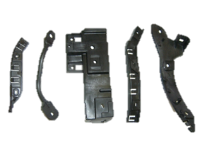

AGS RECYCLING APPROACH
Raw Recycle Directly Converted To High Quality Parts
1
2
3
Raw Recycle | Injection Mold | Parts

Slide 21
AGS RECYCLING APPROACH
Raw Recycle Directly Converted To High Quality Parts
1
2
3
EXTREMELY HARD TO DO
Raw Recycle | Injection Mold | Parts

Slide 22
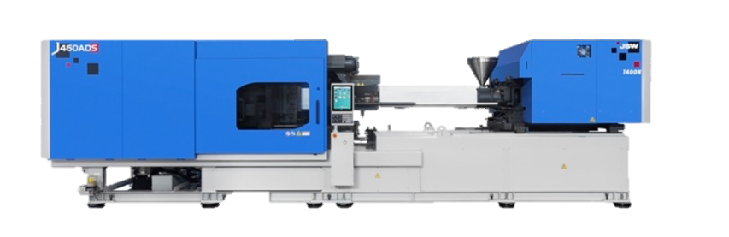
The iMFLUX System
PRESSURE
SENSOR
USER
INTERFACE
SOFTWARE

Slide 23
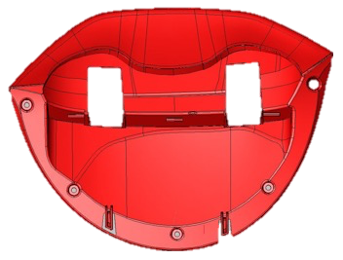
iMFLUX IMPROVES RESULTS
 | PREVIOUS APPROACH | iMFLUX TECHNOLOGY
Operator Adjustments | Frequent | Minimal/None
Scrap Rate | 20% | 3% ( 85%)
Tonnage | 720T | 500T ( 30%)
Cycle Time | 55s | 51s ( 7%)

Slide 24
2
Up to 20%+ energy reduction
Lower clamping energy, Lower tonnage machines
More output per energy
$ facility wide
LOWER ENERGY WEAR & WASTE

Slide 25
REDUCED ENERGY USE
Low Pressure = Less Work = Less Energy Use
FILLING
CLAMPING
Up to 50%
Less Energy Use
PRESSURE
WORK
Up to 50% Less Energy Use
0%
% of FILL
100%
TIME

Slide 26
TYPICAL ENERGY USE PER CYCLE
Conventional Process
Injection
Clamping
Recovery
ENERGY USE
Pack / Hold
Cooling
Mold Open & Close
TIME

Slide 27
TYPICAL ENERGY USE PER CYCLE
iMFLUX Process
Injection
Clamping
Recovery
ENERGY USE
Cooling
Mold Open & Close
TIME

Slide 28
iMFLUX – CONVENTIONAL COMPARISON
UP TO 20%+
LESS ENERGY
Less Injection Energy
No Packing/ Holding Phase
Less Clamp Energy
ENERGY USE
FASTER CYCLE
TIME

Slide 29
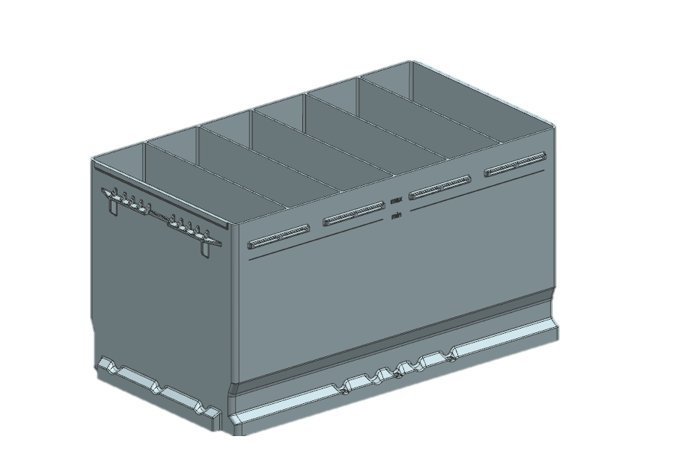
Battery Case Example
Lower Energy Use:
Recycle Use:
Operating Efficiency:
Wear & Tear:
10%+
Up to 90%
(75% PCR, 15% Regrind)
18% Increase
Eliminated Mold
Damage Issue

Slide 30
3
1-3%+ material reduction
Up to 25% light-weighting potential
LIGHTER
PARTS

Slide 31
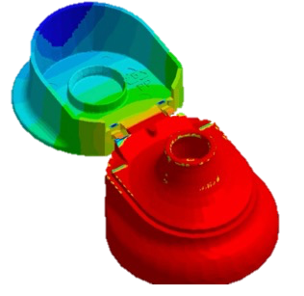
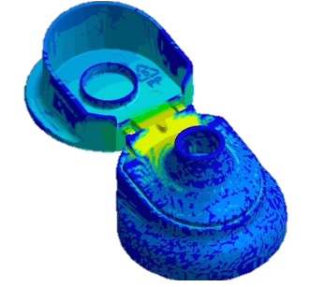
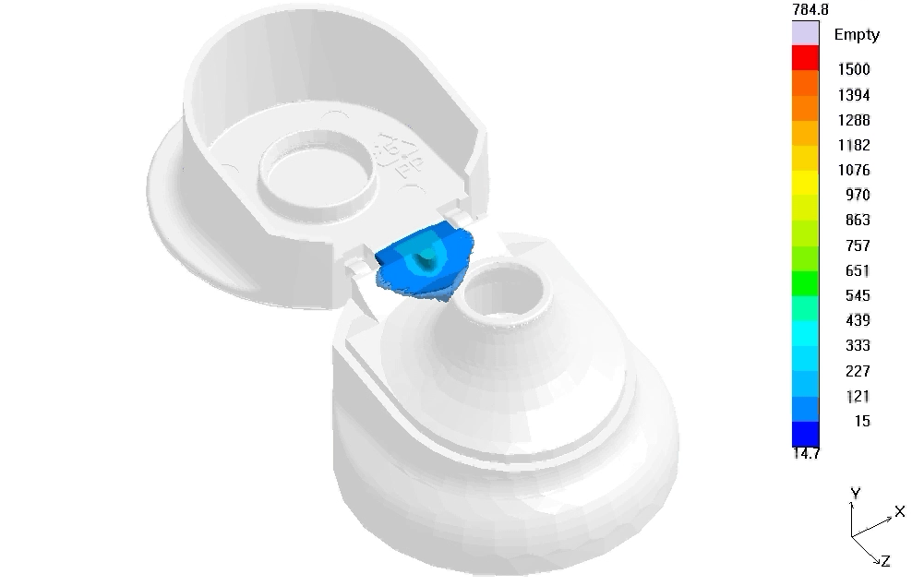

REDUCED PART WEIGHT
Less Pressure Differential Yields 1-3% Lower Part Weight
CONVENTIONAL
iMFLUX
1-3%
Weight Reduction
High Pressure Differential
Low Pressure Differential

Slide 32
REDUCED PART WEIGHT
Lower Filling Pressure Enables Lighter Parts
8000
Lower Pressure
Enables Thin-walling
Conventional
Process
Higher L/T
Lighter Parts
6000
Cavity Pressure
iMFLUX
Process
4000
2000
0.020”
0.030”
0.040”
0.050”
0.060”
Wall Thickness

Slide 33
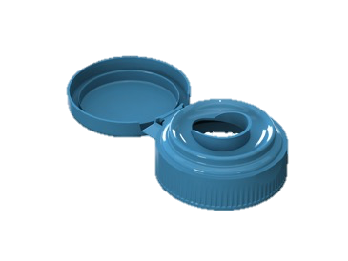
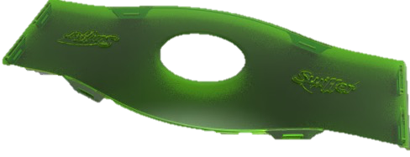
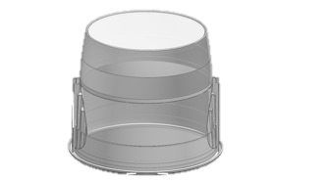
REDUCED PART WEIGHT
Lower Filling Pressure Enables Lighter Parts
Up to 25%
WEIGHT REDUCTION
Up to 35%
WEIGHT REDUCTION
Up to 5%
WEIGHT REDUCTION

Slide 34
WHY DOES ALL THIS MATTER?
Massive Potential To Make The Future Plastics Industry Greener

Slide 35

TYPICAL FACTORY IMPACT
TYPICAL FACTORY
REDUCE
(2% Lighter Parts)
200 Tons/Yr
ELIMINATE
(25% Lighter Parts)
2,500 Tons/Yr
SAVE
ENERGY
(20% Less Energy)
2,720 MWh/Yr
Plastic:
Energy:
10,000 Tons/Yr
13,600 MWh/Yr
Power Chicago for more than 73 days

Slide 36

TOTAL US MARKET IMPACT
Total US Market
REDUCE
(2% Lighter Parts)
0.5M Tons/Yr
ELIMINATE
(25% Lighter Parts)
6M Tons/Yr
Plastic:
Energy:
24M Tons/Yr
72M MWh/Yr
14M MWh/Yr
SAVE
ENERGY
(20% Less Energy)
Power Chicago for more than 13 years

Slide 37
A GREENER PROCESS
1
2
3
Massive potential to
make the future plastics industry Greener
Without the trade-offs to cost, quality, & operational complexity
Many advantages relative to traditional molding

Slide 38
THANK YOU
Join us on the journey and learn how
The Green Curve™ can change the way you mold.
Email: info@imflux.com
Cell: 513.973.2042
Visit us at www.imflux.com

